Slide 1

Connecting Madhwa Community

Slide 2
Vision –
Connect Madhwa community across globe to create , extend and sustain Madhwa culture in fullest extent…

Slide 3
Objective –
One Stop solution to bring Madhwa community in one common platform to create awareness and provide live information on religious details.

Slide 4
Why- Need
  In today's work life people are very busy with their routine work. Society is becoming more busy with their daily routine work & life
  Global Job opportunities , Pushing community to move from Villages / Urbans to metros like Bangalore / Mumbai / Abroad..IT/ITES is the key driver in last two decade
  Opting for easy life..Shortcuts are followed.
  People adopting to new culture of the country / region
  Not connected…Most of the awareness is at the Mathas
  Old family culture is diminishing day by day
  Middle class Society feels left out & need support
  Diverse options available in other social culture and being adopted by youth
  No Easy ways of reaching out society leaders and fear due to lack of knowledge
  Every society leading to online services to attract youths
  Why cannot Madhwa Community?
  Lack of information on Madhwa Mathas in Pilgrimage Places.

Slide 5
  Our Services - Alpha Release
  Purohit Seva – Connect Purohit to directly to community on performing Homa / Pooja / other religious functions
  Online booking and Publish Purohit calendar to check the availability
  Creating Knowledge base – Comprehensive repository on the pooja / homa/ functions
  Comprehensive information on how / when / why / who on the religious functions
  Daily calendar updates with respect to Madhwa Mathas
  Online easy access to chefs and their availability
  Matrimonial services to provide better reach for society

Slide 6
Present Apprehensions
Madwa society is becoming more busy with their daily routine life.
Old family culture is diminishing day by day
Middle class Society feels left out & need support
Diverse options available in other social culture and being adopted by youth
No Easy ways of reaching out society leaders and fear due to lack of knowledge
Every society leading to online services to attract youths

Slide 7
HOW TO CONNECT SOCIETY
Thinking futuristically, every citizen aspire to have easy access to acharyas
Create a system which bridges gap between society and purohits
Increase awareness on service oriented pandits – Society should feel to comfortable

Slide 8
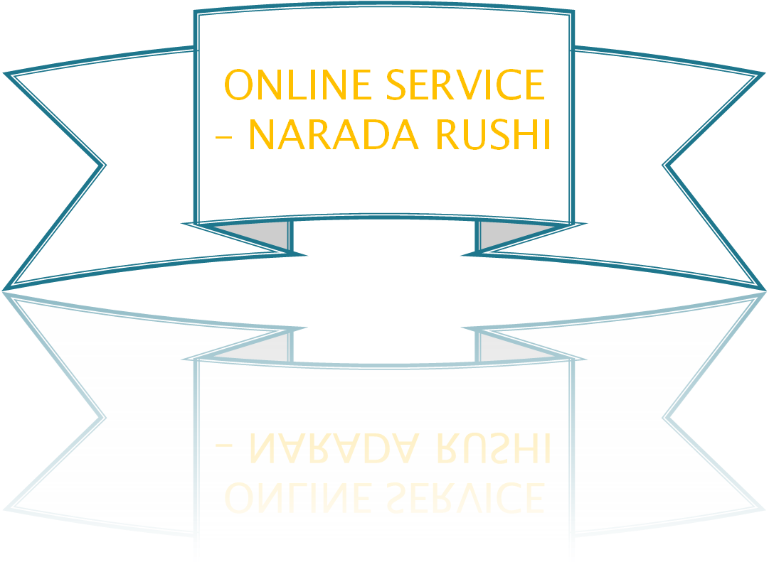
HOW TO CONNECT SOCIETY
SERVICE WHICH WE CAN THINK IS

Slide 9
Vision – Online Solution to Madhwa community across globe to create , extend and sustain Madhwa culture in fullest extent…
Objective – Eliminate gap between citizens & purohits and create atmosphere to initiate dialogues

